Slide 1
Announcements
Upcoming due dates
  Wednesday 11/4, 11:59pm Homework 8
  Friday 10/30, 5pm Project 3
Watch out for Daylight Savings and UTC

Slide 2

CS 188: Artificial Intelligence
Markov Decision Processes
Instructor: Dylan Hadfield-Menell
University of California, Berkeley
Notes:
Please retain proper attribution and the reference to ai.berkeley.edu. Thanks!

Slide 3

Sequential decisions under uncertainty

Slide 4





Example: Grid World
A maze-like problem
  The agent lives in a grid
  Walls block the agent’s path
Noisy movement: actions do not always go as planned
  80% of the time, the action North takes the agent North
  (if there is no wall there)
  10% of the time, North takes the agent West; 10% East
  If there is a wall in the direction the agent would have been taken, the agent stays put
The agent receives rewards each time step
  Small “living” reward each step (can be negative)
  Big rewards come at the end (good or bad)
Goal: maximize sum of rewards
Notes:
[cut demo of moving around in grid world program]

Slide 5
Markov Decision Processes
An MDP is defined by:
  A set of states s ∈ S
  A set of actions a ∈ A
  A transition model T(s, a, s’)
    Probability that a from s leads to s’, i.e., P(s’| s, a)
  A reward function R(s)
    Sometimes depends on next state and action: R(s, a, s’)
  A start state
  Possibly a terminal state (or absorbing state) with zero reward for all actions
MDPs are fully observable but probabilistic search problems
  Some instances can be solved with expectimax search
  We’ll have a new tool soon
[Demo – gridworld manual intro (L8D1)]
Notes:
In search problems: did not talk about actions, but about successor functions --- now the information inside the successor function is unpacked into actions, transitions and reward
Write out S, A, example entry in T, entry in R
Reward function different from the book : R(s,a,s’)
In book simpler for equations, but not useful for the projects.
Need to modify expectimax a tiny little bit to account for rewards along the way, but that’s something you should be able to do, and so you can already solve MDP’s (not in most efficient way)

Slide 6

Policies
In deterministic single-agent search problems, we wanted an optimal plan, or sequence of actions, from start to a goal
For MDPs, we want an optimal policy π*: S → A
  A policy π gives an action for each state
  An optimal policy maximizes expected utility
  An explicit policy defines a reflex agent
Expectimax didn’t compute entire policies
  It computed the action for a single state only
  It doesn’t know what to do about loops
Optimal policy when R(s) = -0.04 for all non-terminals s
Notes:
Dan has a DEMO for this.

Slide 7
Some optimal policies for R<0
R(s) = -0.01
R(s) = -0.03
R(s) = -0.4
R(s) = -2.0
Notes:
R(s) = the “living reward”
SHOW +ve R policy!

Slide 8
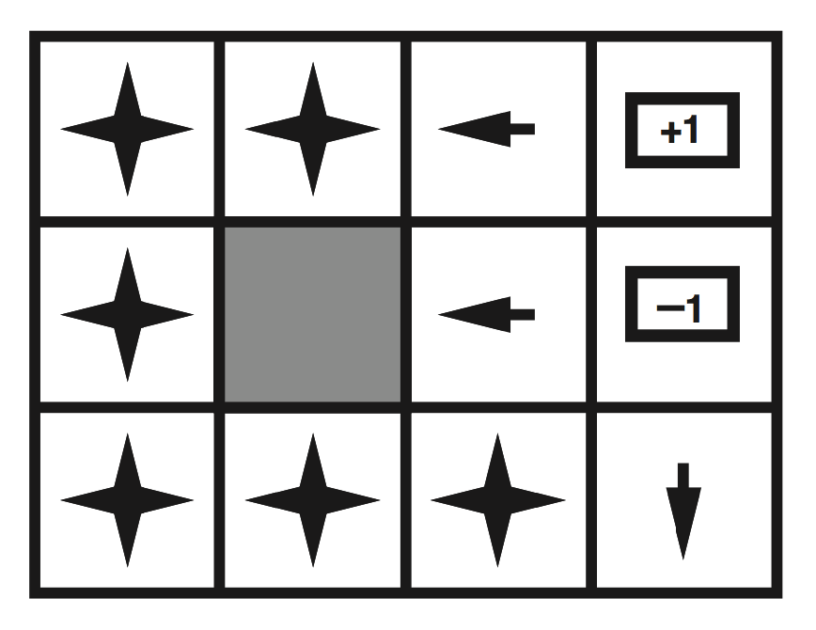
Optimal policy for R>0
R(s) > 0

Slide 9

Utilities of Sequences

Slide 10
Utilities of Sequences
What preferences should an agent have over reward sequences?
More or less?
Now or later?
[1, 2, 2]
or
[2, 3, 4]
[0, 0, 1]
or
[1, 0, 0]

Slide 11

Stationary Preferences
Theorem: if we assume stationary preferences:
[a₁, a₂, …] > [b₁, b₂, …] ⇔ [c, a₁, a₂, …] > [c, b₁, b₂, …]
then there is only one way to define utilities:
  Additive discounted utility:
  U([r₀, r₁, r₂,…]) = r₀ + γr₁ + γ²r₂ + …
  where γ ∈ [0,1] is the discount factor

Slide 12


Discounting
Worth r now
Worth γr next step
Worth γ²r in two steps
Discounting with conveniently solves the problem of infinite reward streams!
  Geometric series: 1 + γ + γ² + … = 1/(1 - γ)
  Assume rewards bounded by ± R_{max}
  Then r₀ + γr₁ + γ²r₂ + … is bounded by ± R_{max}/(1 - γ)
(Another solution: environment contains a terminal state (or absorbing state) where all actions have zero reward; and agent reaches it with probability 1)

Slide 13


Quiz: Discounting
Given:
  Actions: East, West, and Exit (only available in exit states a, e)
  Transitions: deterministic
Quiz 1: For γ = 1, what is the optimal policy?
Quiz 2: For γ = 0.1, what is the optimal policy?
Quiz 3: For which γ are West and East equally good when in state d?

Slide 14
Recap: Defining MDPs
Markov decision processes:
  A set of states s ∈ S
  A set of actions a ∈ A
  A transition model T(s, a, s’) or P(s’| s, a)
  A reward function R(s)
  A start state
MDP quantities so far:
  Policy = Choice of action for each state
  Utility = sum of (discounted) rewards for a state/action sequence

Slide 15
Solving MDPs

Slide 16
The value of a policy
  Executing a policy π from any state s₀ generates a sequence
    s₀, π(s₀), s₁, π(s₁), s₂, …
  This corresponds to a sequence of rewards
    R(s₀, π(s₀), s₁), R(s₁,π(s₁), s₂), …
  This reward sequence happens with probability
    P(s₁ | s₀, π(s₀)) x P(s₂ | s₁, π(s₁)) x …
  The value (expected utility) of π in s₀ is written V^{π}(s₀)
    It’s the sum over all possible state sequences of (discounted sum of rewards) x (probability of state sequence)
  (Note: the book uses U instead of V; technically this is more correct but the MDP and RL literature uses V.)
s₀
a₀
s₀, a₀
s₀,a₀,s₁
s₁

Slide 17
Optimal Quantities
The optimal policy:
  π*(s) = optimal action from state s
  Gives highest V^{π}(s) for any π
The value (utility) of a state s:
  V*(s) = V^{π*}(s) = expected utility starting in s and acting optimally
The value (utility) of a q-state (s,a):
  Q*(s,a) = expected utility of taking action a in state s and (thereafter) acting optimally
  V*(s) = max_{a}Q*(s,a)
s
s is a state
a
(s, a) is a q-state
s, a
s,a,s’
(s,a,s’) is a
transition
s’
Notes:
[Note: this demo doesn’t show anything in action, just pops up V and Q values.]

Slide 18

Snapshot of Demo – Gridworld V Values
Noise = 0.2
Discount = 0.9
Living reward = 0
Notes:
This demo doesn’t show anything in action, it just shows the V and Q values.

Slide 19

Snapshot of Demo – Gridworld Q Values
Noise = 0.2
Discount = 0.9
Living reward = 0
Notes:
This demo doesn’t show anything in action, it just shows the V and Q values.

Slide 20
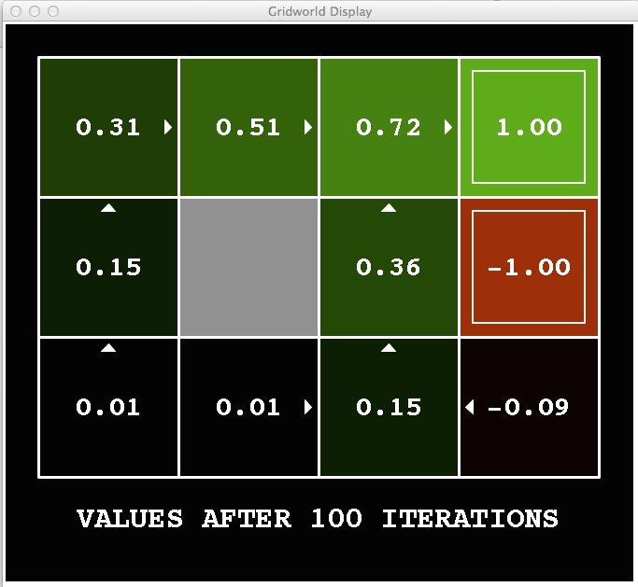
Snapshot of Demo – Gridworld V Values
Noise = 0.2
Discount = 0.9
Living reward = -0.1
Notes:
This demo doesn’t show anything in action, it just shows the V and Q values.

Slide 21
Bellman equations (Shapley, 1953)
The value of a state is
  the value of taking the best action and acting optimally thereafter
  = expected reward for the action + (discounted) value of the resulting state
Hence we have a recursive definition of value:
  V*(s) = max_{a} R(s) + γ∑_{s’} P(s’ | a,s) V*(s’)
Immediate expected reward
Expected future rewards

Slide 22

Value Iteration

Slide 23
Solving the Bellman equations
OK, so we have |S| simultaneous nonlinear equations with |S| unknowns V(s), one per state:
  V*(s) = max_{a} R(s) + γ∑_{s’} P(s’ | a,s) V*(s’)
  How do we solve equations of the form x = f(x)? E.g., x = cos x?
  Try iterating x ← cos x!
    x₁ ← cos x₀
    x₂ ← cos x₁
    x₃ ← cos x₂
    etc.

Slide 24
Value Iteration
Start with (say) V₀(s) = 0 and some termination parameter ε
Repeat until convergence (i.e., until all updates smaller than ε(1-γ)/γ )
  Do a Bellman update (essentially one ply of expectimax) from each state:
  V_{k+1}(s) ← max_{a} R(s) + γ∑_{s’} P(s’ | a,s) V*(s’)
Theorem: will converge to unique optimal values
V ← BV
Notes:
Discuss computational complexity: S * A * S times number of iterations
Note: updates not in place [if in place, it means something else and not even clear what it means]

Slide 25

k=0
Noise = 0.2
Discount = 0.9
Living reward = 0
Notes:
Assuming zero living reward

Slide 26

k=1
Noise = 0.2
Discount = 0.9
Living reward = 0
Notes:
Assuming zero living reward

Slide 27

k=2
Noise = 0.2
Discount = 0.9
Living reward = 0
Notes:
Assuming zero living reward

Slide 28

k=3
Noise = 0.2
Discount = 0.9
Living reward = 0
Notes:
Assuming zero living reward

Slide 29

k=4
Noise = 0.2
Discount = 0.9
Living reward = 0
Notes:
Assuming zero living reward

Slide 30

k=5
Noise = 0.2
Discount = 0.9
Living reward = 0
Notes:
Assuming zero living reward

Slide 31

k=6
Noise = 0.2
Discount = 0.9
Living reward = 0
Notes:
Assuming zero living reward

Slide 32

k=7
Noise = 0.2
Discount = 0.9
Living reward = 0
Notes:
Assuming zero living reward

Slide 33

k=8
Noise = 0.2
Discount = 0.9
Living reward = 0
Notes:
Assuming zero living reward

Slide 34

k=9
Noise = 0.2
Discount = 0.9
Living reward = 0
Notes:
Assuming zero living reward

Slide 35

k=10
Noise = 0.2
Discount = 0.9
Living reward = 0
Notes:
Assuming zero living reward

Slide 36

k=11
Noise = 0.2
Discount = 0.9
Living reward = 0
Notes:
Assuming zero living reward

Slide 37

k=12
Noise = 0.2
Discount = 0.9
Living reward = 0
Notes:
Assuming zero living reward

Slide 38

k=100
Noise = 0.2
Discount = 0.9
Living reward = 0
Notes:
Assuming zero living reward

Slide 39
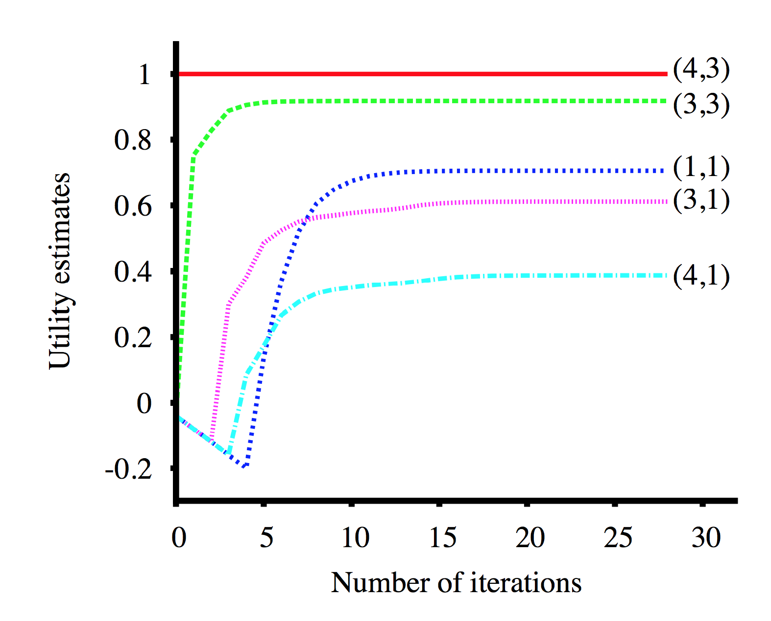
Values over time
Noise=0.2
Discount = 1
Living reward = -0.04

