Slide 1
Weather Monitoring System

Slide 2
User Requirements
Design a weather monitoring system that detects the following parameters
  Temperature
  Pressure
  Relative humidity
  Wind Speed
  Wind Direction
  Rainfall
  Solar Radiation
This information is sent to a remote system every 5 minutes

Slide 3
All parameters sensed - every minute

Slide 4
Every 5 minutes – data collected
Averaged & sent to Central computer

Slide 5
Communication is Serial
Wired
RS232C in null Modem
Communication Speed is 9600 Baud

Slide 6
Temperature
Range: - 20° C to + 50° C
Resolution - 1° C

Slide 7
Wind Speed
Range: 0-100 MPH
Resolution: 0.5 MPH

Slide 8
Wind Direction
Range: 0 to 360°
Resolution: 2º

Slide 9
Pressure
Range: 800-1100 millibars
Resolution: 2 millibars

Slide 10
Humidity- Relative Humidity
Range: 0 -100%
Resolution: 1%

Slide 11
Solar Radiation
Range: 0 -1500W/m²
Resolution: 10W/m²

Slide 12
Rainfall
Range: 0 -20 mm/min
Resolution: 0.1mm /min

Slide 13
Weather Monitoring System
Step 1 of the Design

Slide 14
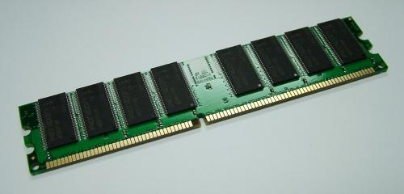
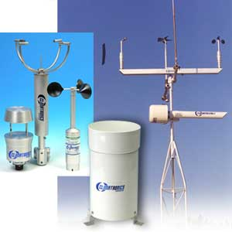
Where to start ?

Slide 15
Sensors
Analog Output
  Varying Current
  Varying Voltage
Serial Digital output
Pulses/ Second

Slide 16
Temperature Sensor
System Specifications
WE 700
Range: - 20° C to +50° C
Resolution: - 1° C
Output: 4-20mA
Range: -50° C to + 50° C
Resolution: 2° F or 1° C
Operating Voltage: 10-36VDC
Warm Up Time: 5 seconds minimum
Operating Temperature: -50°C to +100°C

Slide 17
Wind Speed Sensor
Sensor Specifications
WE 550
Range: 0-100 MPH
Resolution: 0.5 MPH
Output: 4-20mA
0-100 MPH
Resolution: .5 MPH over the range 11 to 55 MPH
Operating Voltage: 10-36VDC
Warm Up Time: 3 seconds minimum
Operating Temp: -40° to +55°C

Slide 18
Wind Direction Sensor
Sensor Specifications
WE570
Range: 0 to 360°
Resolution: 2º
Output 4-20 mA
Range 0 to 360°
Sensitivity 1 m/s (2.2 mph)
Resolution 1% full scale
Operating Voltage 10 to 36 VDC
Warm-up Time 3 seconds minimum
Operating Temperature:-40° to +55°C

Slide 19
Barometric Pressure Sensor
System Specification
WE 100
Range: 800-1100 millibars
Resolution: 2 millibars
Output: 4-20mA
Range: 800-1100 millibars
Resolution: 0.5% of full scale
Operating Voltage: 10-36VDC
Warm Up Time: 3 seconds minimum
Operating Temp: -40° to +55°C ,

Slide 20
Relative Humidity
System Specifications
WE 600
Range: 0 -100%
Resolution: 1%
Output: 4-20mA
Range: 0-100% RH
Resolution: + 0.5% RH
Operating Voltage: 10-36VDC
Current Draw: 3 mA plus sensor
Warm Up Time: 3 seconds minimum
Operating Temp: -40° to +55°C

Slide 21
Solar Radiation Sensor
Sensor Specifications
WE 300
Range: 0 -1500W/m²
Resolution: 10W/m²
Output: 4-20mA
Range: 0-1500 W /m²
Resolution: 1% of full scale
Operating Voltage: 10-36VDC
Warm Up Time: 3 seconds minimum
Operating Temperature: -40°C to +55°C.

Slide 22
Rainfall
System Specifications
Lambrecht – Precipitation sensor
Range: 0 -20 mm/min
Resolution: 0.1mm /min
Output: 4-20mA
Range: 0-25 mm/m
Resolution: 0.1mm/min
Operating Voltage: 10-36VDC
Current Draw: 3 mA plus sensor
Warm Up Time: 3 seconds minimum
Operating Temp: -40° to +55°C

Slide 23
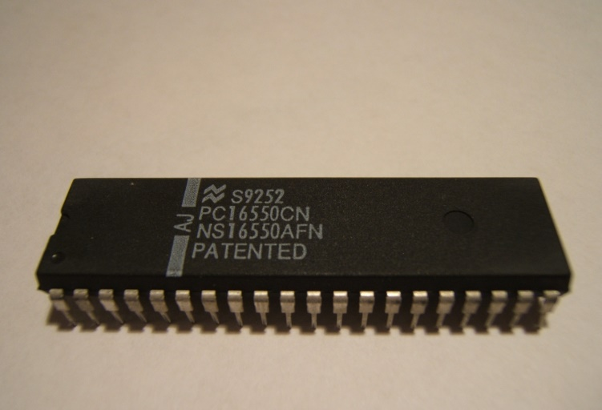
Output
System Specifications
16550
Communication is Serial
Wired
RS232C in null Modem
Communication Speed is 9600 Baud

Slide 24
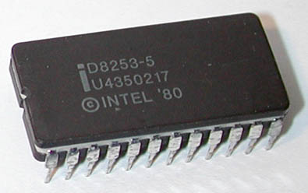
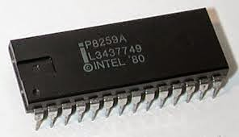
Timing
System Specifications
8253/8259
Every 5 minutes – data collected
Every 1 Minute – Data Sensed

Slide 25
Weather Monitoring System
Step 2 Interfacing the sensor

Slide 26
Step 2 : How to interface Sensor to system
Analog Current 4 -20 mA
Generally Measure Voltage
Current to Voltage Conversion ??

Slide 27
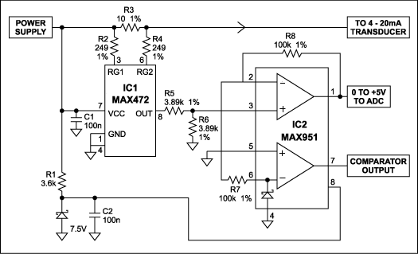
Current to Voltage Conversion
1.25
6.25
0V
5V

Slide 28
Analog to Digital
7 Analog outputs from 0-5V
Size of ADC
  Resolution of sensor
  19.6mv ( 8-bit ADC)
  (5.0 – 0.0 )V/256

Slide 29
Sensor Resolution Vs ADC Resolutions
Temperature Sensor
ADC
256
19.6 mV
Range: - 20° C to +50° C
Resolution: - 1° C
70
5/70
71.4 mV

Slide 30
Sensor Resolution Vs ADC Resolutions
Wind Speed Sensor
ADC
Range: 0-100 MPH
Resolution: 0.5 MPH
200
5.0/ 200
25mV
256
19.6 mV

Slide 31
Sensor Resolution Vs ADC Resolutions
Wind Direction Sensor
ADC
Range: 0 to 360°
Resolution: 2º
180
5.0/ 180
27.78mV
256
19.6 mV

Slide 32
Sensor Resolution Vs ADC Resolutions
Pressure Sensor
ADC
Range: 800-1100 millibars
Resolution: 2 millibars
150
5.0/ 150
33.3mV
256
19.6 mV

Slide 33
Sensor Resolution Vs ADC Resolutions
Relative Humidity Sensor
ADC
Range: 0 -100%
Resolution: 1%
100
5.0/ 100
50mV
256
19.6 mV

Slide 34
Sensor Resolution Vs ADC Resolutions
Solar Radiation Sensor
ADC
Range: 0 -1500W/m²
Resolution: 10W/m²
150
5.0/ 100
50mV
256
19.6 mV

Slide 35
Sensor Resolution Vs ADC Resolutions
Rainfall Sensor
ADC
Range: 0 -20 mm/min
Resolution: 0.1mm /min
200
5.0/ 200
25mV
256
19.6 mV

Slide 36
Step 2 : How to interface Sensor to system
No of analog i/ps-7
8-channel ADC
8-bit
0808 – 8 channel, 8-bit ADC

Slide 37
CLK
IN₀ IN₁ IN₂ IN₃ IN₄ IN₅ IN₆ IN₇
Analog
I/ps
DB₀ –DB₇
AD₀
AD₁
AD₂
V_{REF+}
5V
V_{REF-}
0V
EOC
Vcc
Supply
OE
GND
SOC
5 V = 19.6078 mV
255
ALE
ADC 0808

Slide 38
Interface the ADC

Slide 39
How to interface ADC to 8086 ?
2 ports available use it for ADC

Slide 40
1 MHz
CLK
IN₀ IN₁ IN₂ IN₃ IN₄ IN₅ IN₆ IN₇
sensors
PB₀ –PB₇
DB₀ –DB₇
PC₀ PC₁ PC₂
AD₀
AD₁
AD₂
V_{REF+}
5V
INTR
V_{REF-}
0V
EOC
PC₃
Vcc
Supply
OE
PC₄
GND
SOC
PC₅
ALE
ADC 0808

Slide 41
Generate 1 MHz
Use 8254
Any other timing
Read every 1 Minute

Slide 42
STEP 3 : 1 MHz clock & 5 MIN Interrupt
Use 8254

Slide 43
ADC CLK
1 MHz
Count = 5_{d}
5 MHz
CLK₀
OUT₀
5V
GATE₀
mode₃
100 Hz
OUT₁
CLK₁
5 MHz
Count = 50000_{d}
5V
GATE₁
mode₂
1 minute
Count =6000_{d}
CLK₂
OUT₂
5V
GATE₂
mode₂
TIMER INT

Slide 44
STEP 4: Interrupt Generation
Use 8259

Slide 45
8259
INT
IR₀
Timer
INTA
IR₁
ADC
CAS₀ CAS₁ CAS₂
SP/EN
5V

Slide 46
Step 5: Output Interface
Serial Port Null Modem
 | 16550
 |  | DTR
RTS |  | DSR
CTS |  | DCD
RXD
TXD

Slide 47
STEP 6: How to interface 8255, 8254 & 8259,16550
Memory mapped/ IO mapped ?
Fixed/ Variable addressing ?
Address
80 - 86_{H} -8255
90_{H} - 96_{H} – 8254
A0_{H} – A2_{H} - 8259
B0_{H} - BE_{H} - 16550
Incremental Addressing

Slide 48
LS138
8255
A₆ A₅ A₄
O₀
I₂ I₁ I₀
O₁
8254
O₂
8259
O₃
16550
M/IO’
G_{2B}
G_{2A} G₁
A₇
A₀

Slide 49
STEP 7: HOW to Interface Memory
How much memory ?
ROM/RAM?
RAM – minimum 2k chip- 4k
ROM – minimum 2k chip – 4k + 4k
ROM1 00000_{H}
ROM2 FF000_{H}
RAM 01000_{H}

Slide 50
LS138
ROM₁
A₁₆ A₁₃ A₁₂
O₀
I₂ I₁ I₀
O₁
RAM
A₀
WR’
WRL’
GND
G_{2B}
O₇
ROM₂
WRH’
BHE’
WR’
G_{2A} G₁
M/IO’
GND
Memory Decoder

Slide 51
Interface to the processor
A₁
A₀
A₂
A₁
CS
8255
RD
RD
WR
WR
D₀ – D₇
D₀ – D₇
RESET from 8284
RESET

Slide 52
LS373
A₁₆-A₁₉ S₆-S₃
A₁₆-A₁₉
BHE’/S₇
BHE’
G
OE’
ALE
8086
LS373
AD₈-AD₁₅
A₈-A₁₅
G
OE’
LS373
AD₀-AD₇
A₀-A₇
G
OE’
MN/MX’
5V
System Bus of 8086 (Address)

Slide 53
LS244
MEMR
RD
LOGIC
CIRCUIT
MEMW
WR
IOR
IO/M
OE’
IOW
8086
LS245
AD₈-AD₁₅
D₈-D₁₅
DT/R’
DIR
OE’
DEN’
LS245
AD₀-AD₇
D₀-D₇
DIR
OE’
MN/MX’
5V
System Bus of 8086(Data + Control)
next

Slide 54
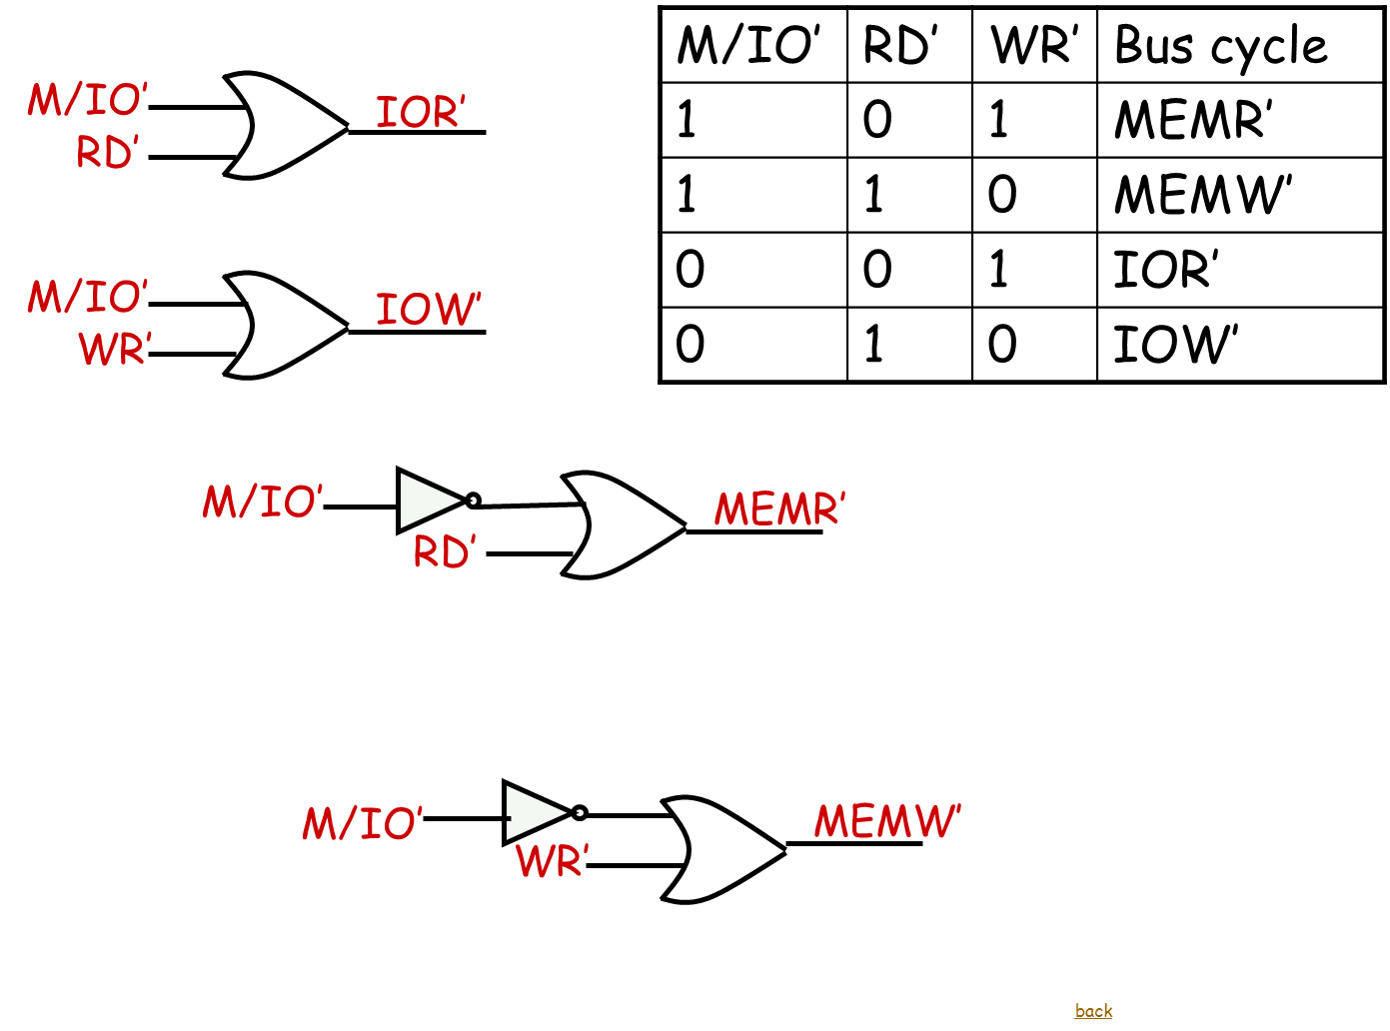

Slide 55
5 V
VCC
MN/MX
15 M Hz
RESET
8284
CLK
READY
NMI
HOLD
GND
8086 Inputs

Slide 56
Step 8: Software
A
B
Main
Start Conversion
for sensor
16550 send data
Branch to end
of IVT
Wait for
Int
Initialize 8255,
8254,8259
Wait for
5 min INT
All
sensors
read
N
A
Y
ISR₁
ISR₂
B
SOC (S1-S6)
Read ADC
IRET
IRET

Slide 57
Step 8: Software - ISR
A
ISR 1
N
All
sensors
read
ISR₂
Start Conversion
for sensor
Read ADC
Enable INT
Y
Send via 16550
IRET
Wait for
Int
IRET
A

Slide 58
Initializing 8255
i8255: mov al,10000010_{b}
out 86_{H} , al

Slide 59
Initializing 8254
i8254: mov al,00110110b
out 8E_{H} , al
mov al,01110101b
out 8E_{H} , al
mov al,10110101b
out 8E_{H} ,al

Slide 60
Initializing 8254
mov al,5
out 88_{H} , al
mov al,0
out 88_{H} , al
mov al,50h
out 8A_{H} , al
mov al,0C3h
out 8A_{H} , al
mov al,30h
out 8C_{H} ,al
mov al,75h
out 8C_{H} , al

Slide 61
Initialising 8259
I8259: mov al,1111 1100b
out 90h,al
mov al,1000 0000b
out 92h,al
mov al,0000 0011b
out 92h,al
mov al,1111 1100b
out 92h,al

Slide 62
16550 Initialization
9600 baud
8 data
Odd parity
1 stop
SA – F0_{H}

Slide 63
16550 initialization
LINE EQU 0A6H
LSB EQU 0A0H
MSB EQU 0A2H
FIFO EQU 0A4H
INIT:
  MOV AL,10001011B
  OUT LINE,AL
  MOV AL,120
  OUT LSB,AL
  MOV AL,0
  OUT MSB,AL
  MOV AL,00001011B
  OUT LINE,AL

